Slide 1


ANALYSIS OF ONLINE RETAIL SALES
INFO 523 DATA MINING
COLLEGE OF INFORMATION SCIENCE
TEAM 6:
PRAJWAL SATHYANARAYANA
PRAGNYA NARASIMHA
HEMANATH ARUMUGAM

Slide 2

INTRODUCTION
The Online Retail Dataset provides a comprehensive view of customer purchasing behavior, allowing for an in-depth analysis of sales patterns, customer preferences, and product performance.
Our approach involves implementing a comprehensive data mining strategy, including clustering, association rule mining, and classification algorithms, to analyze and interpret the data.
ANALYSIS OF ONLINE RETAIL SALES | INFO 523 DATA MINING | COLLEGE OF INFORMATION SCIENCE | UNIVERSITY OF ARIZONA
Notes:
- The Online Retail Dataset is a transactional dataset that captures sales data from an e-commerce platform.
- This dataset provides a comprehensive view of customer purchasing behavior, allowing for in-depth analysis of sales patterns, customer preferences, and product performance.

Slide 3

DATASET
Dataset Overview
Name: Online Retail Dataset
Source: UCI Machine Learning Repository
Data Types
Nominal: StockCode, Country, Description
Numerical: Quantity, UnitPrice, Amount
Temporal: InvoiceDate
Key Fields
InvoiceNo, StockCode, Description, Quantity, InvoiceDate, UnitPrice, CustomerID, Country
Dataset Size
~400,000 transactions
ANALYSIS OF ONLINE RETAIL SALES | INFO 523 DATA MINING | COLLEGE OF INFORMATION SCIENCE | UNIVERSITY OF ARIZONA
Notes:
- The dataset consists of approximately 500,000 transactions from an online retail store, capturing sales data over a specific period. It includes key attributes such as InvoiceNo, StockCode, Description, Quantity, InvoiceDate, UnitPrice, CustomerID, and Country.

Slide 4
DATA CLEANING
We conducted an initial assessment of the dataset to identify missing values across different columns.
The percentage of missing values was calculated for each column to quantify the data quality.
ANALYSIS OF ONLINE RETAIL SALES | INFO 523 DATA MINING | COLLEGE OF INFORMATION SCIENCE | UNIVERSITY OF ARIZONA

Slide 5
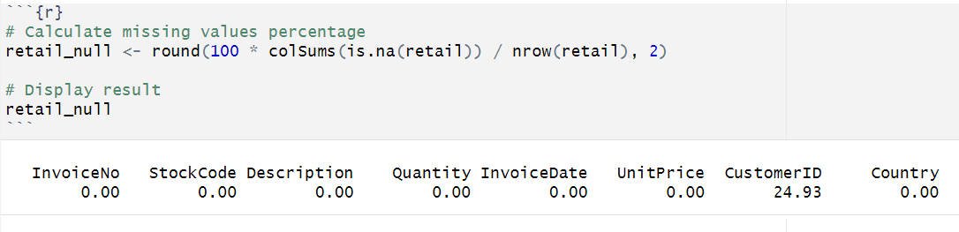
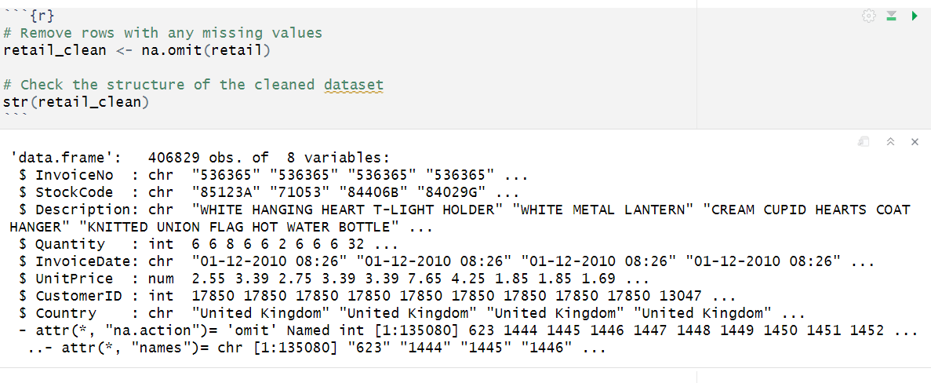
DATA CLEANING
ANALYSIS OF ONLINE RETAIL SALES | INFO 523 DATA MINING | COLLEGE OF INFORMATION SCIENCE | UNIVERSITY OF ARIZONA
Notes:
Here, we can observe that customer id column has around 25% of missing values.
And the rows with missing values are omitted.

Slide 6
DATA PRE PROCESSING
Converted InvoiceDate to a datetime object using dmy_hm() for consistency.
RFM Metrics:
Monetary: Total amount spent by each customer.
Frequency: Number of unique invoices for each customer.
Recency: Days since the last purchase for each customer.
ANALYSIS OF ONLINE RETAIL SALES | INFO 523 DATA MINING | COLLEGE OF INFORMATION SCIENCE | UNIVERSITY OF ARIZONA

Slide 7
DATA PRE PROCESSING
3. Renamed Amount.x to Amount and Amount.y to Monetary for clarity.
4. Computed the difference between the maximum transaction date and individual InvoiceDate (in days) as a new column Diff.
ANALYSIS OF ONLINE RETAIL SALES | INFO 523 DATA MINING | COLLEGE OF INFORMATION SCIENCE | UNIVERSITY OF ARIZONA

Slide 8
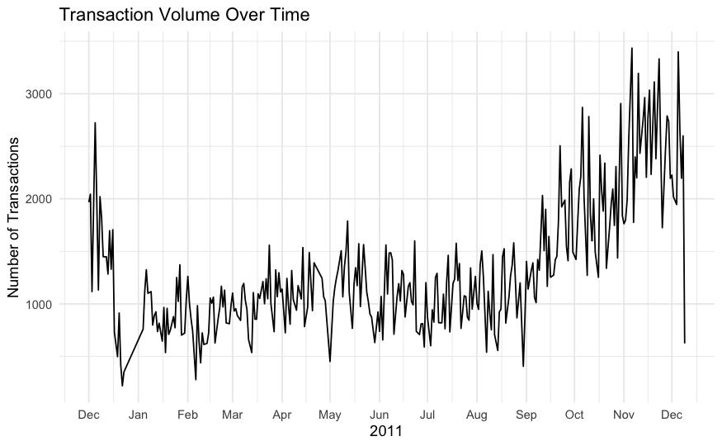
DATA EXPLORATION
Transaction volume exhibits a steady increase starting from mid-year, peaking in the months leading up to December, likely due to holiday shopping.
A notable dip is observed in January, which could be attributed to post-holiday season slowdown.
ANALYSIS OF ONLINE RETAIL SALES | INFO 523 DATA MINING | COLLEGE OF INFORMATION SCIENCE | UNIVERSITY OF ARIZONA

Slide 9
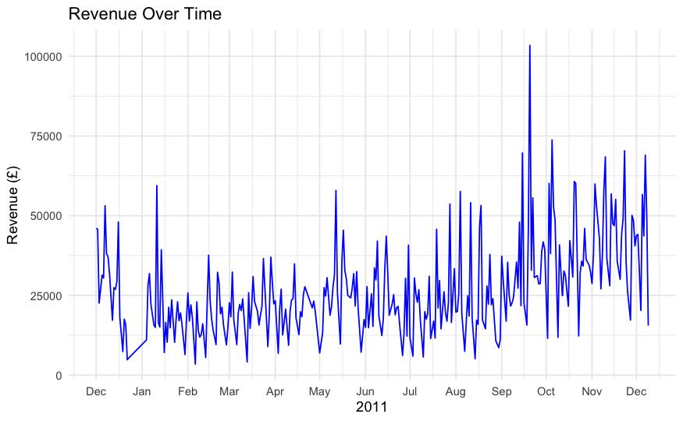
DATA EXPLORATION
Revenue shows a fluctuating pattern, with notable peaks observed in the months of September and December, likely driven by seasonal sales events.
A sharp dip in revenue is evident during January, aligning with post-holiday shopping slowdown.
ANALYSIS OF ONLINE RETAIL SALES | INFO 523 DATA MINING | COLLEGE OF INFORMATION SCIENCE | UNIVERSITY OF ARIZONA

Slide 10
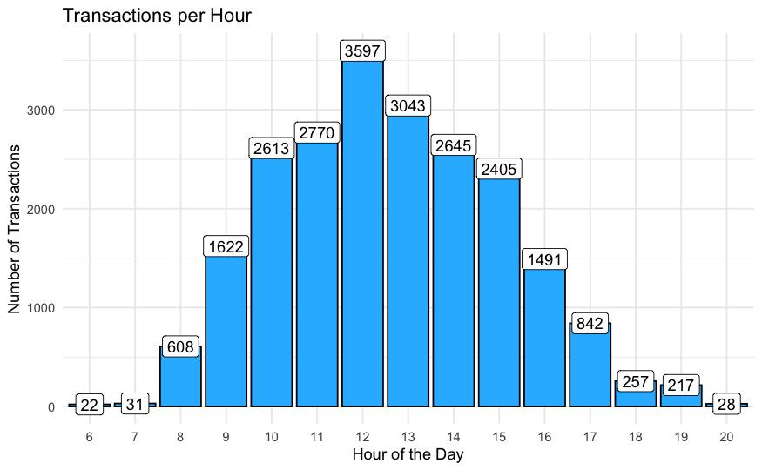
DATA EXPLORATION
Transactions peak during midday hours, particularly between 11:00 AM and 2:00 PM, suggesting a high level of customer activity during this period.
Early morning (before 9:00 AM) and late evening (after 6:00 PM) show significantly lower transaction volumes, indicating reduced business activity during these hours.
ANALYSIS OF ONLINE RETAIL SALES | INFO 523 DATA MINING | COLLEGE OF INFORMATION SCIENCE | UNIVERSITY OF ARIZONA

Slide 11
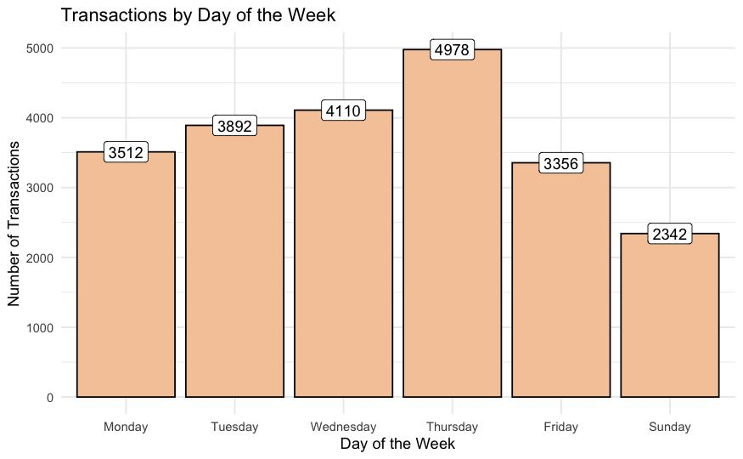
DATA EXPLORATION
Transaction volume is highest on Thursdays and lowest on Sundays, indicating a peak in business activity towards the end of the week.
Weekends (Saturday and Sunday) exhibit lower transaction volumes compared to weekdays, suggesting reduced business operations or customer activity during this period.
ANALYSIS OF ONLINE RETAIL SALES | INFO 523 DATA MINING | COLLEGE OF INFORMATION SCIENCE | UNIVERSITY OF ARIZONA

Slide 12
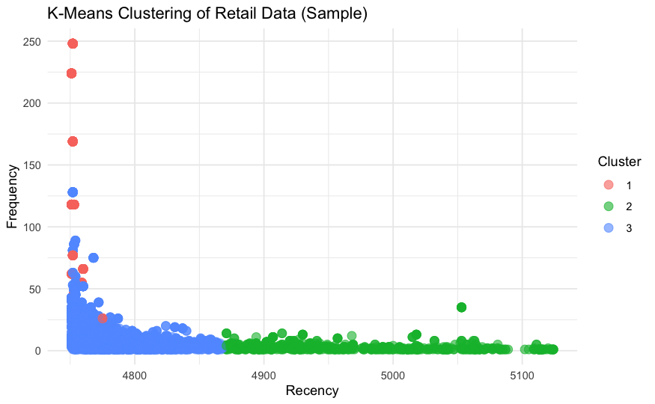
CLUSTERING ALGORITHM - K MEANS CLUSTERING
Cluster Insights: The silhouette plot indicates that Cluster 3 (blue) has the highest cohesion and separation, contributing positively to the clustering quality.
Optimal Clustering: The average silhouette width of ~0.75 demonstrates well-defined clusters, validating the choice of 3 clusters based on the Elbow Method.
ANALYSIS OF ONLINE RETAIL SALES | INFO 523 DATA MINING | COLLEGE OF INFORMATION SCIENCE | UNIVERSITY OF ARIZONA
Notes:
K means clustering is used to group data points based on number of clusters
The number of clusters decided is 3
Eucledian distance is used to determine the closeness of points to the centroid
Since the dataset is very huge, we have sampled only 7000 rows
So we have a scatter plot here which plots recency against frequency
Each data point on the scatter plot corresponds to an individual observation
The k-means algorithm assigns each data point to one of the k clusters. In the scatter plot, the data points colored according to the cluster assignment, here it is red, blue and green

Slide 13
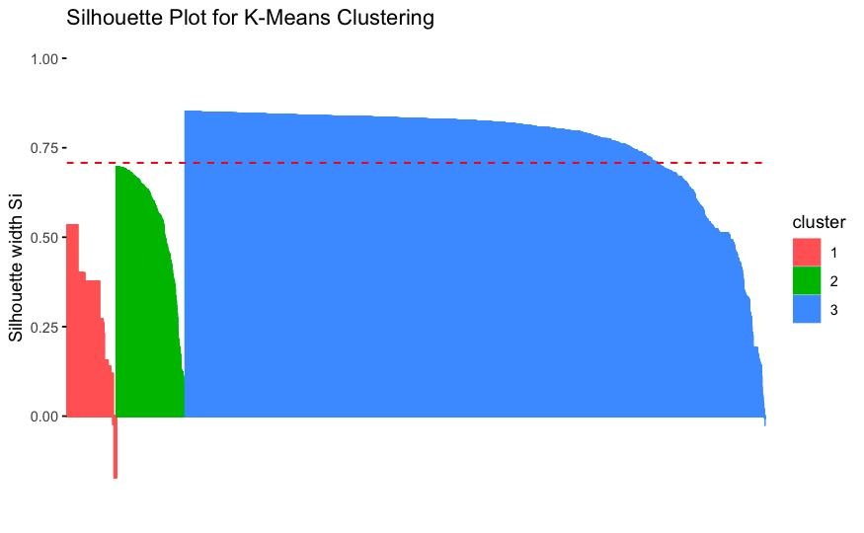
Average Silhouette score for K Means Clustering is 0.708, implying a strong clustering structure
Notes:
average silhouette score across all data points provides an overall evaluation of the clustering quality.
Higher average silhouette scores (closer to 1) suggest well-defined and separated clusters.
The cluster 1 represented by red color has a few outliers which can be observed

Slide 14
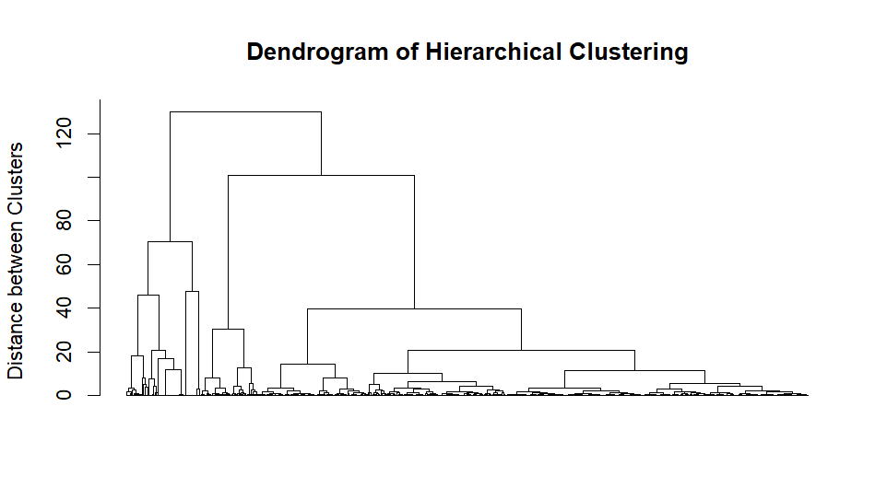
CLUSTERING ALGORITHM - HIERARCHICAL CLUSTERING
ANALYSIS OF ONLINE RETAIL SALES | INFO 523 DATA MINING | COLLEGE OF INFORMATION SCIENCE | UNIVERSITY OF ARIZONA
Notes:
Hierarchical clustering doesn not require any assignment of number of clusters as compared to k means clustering
This clustering can be visualized using dendogram, which is a tree like diagram which shows the relationship between data points and clusters
The hierarchical clustering is implemented using ward method, which minimizes the variance within clusters
The dendrogram starts with each data point as its own cluster, and as you move up the y-axis, the clusters are progressively merged until all the data points are in a single cluster.
The horizontal lines in the dendrogram represent the clusters, and the vertical lines indicate the distances at which the clusters are merged.

Slide 15
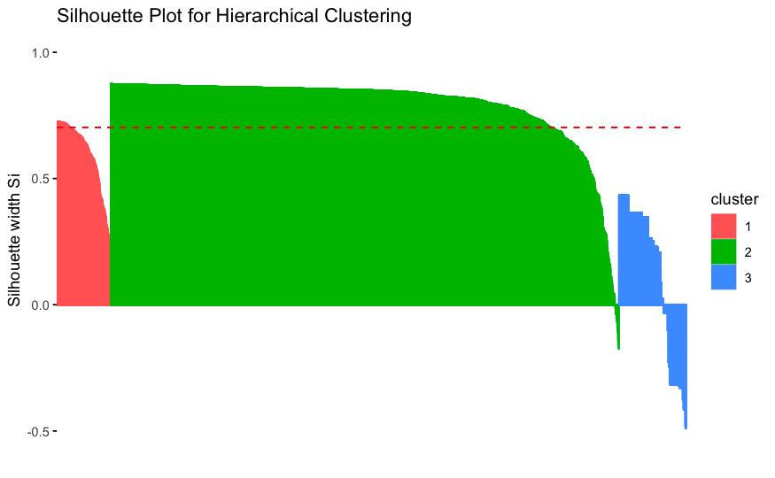
Cluster Cohesion and Separation: The silhouette plot demonstrates that Cluster 2 (green) has the highest silhouette width, indicating strong cohesion and clear separation from other clusters, whereas Cluster 3 (blue) shows poor cluster quality.
Hierarchical Clustering Efficiency: With an average silhouette width of approximately 0.5, the clustering structure is moderately defined, suggesting scope for further tuning or testing alternate distance measures.
Average Silhouette score for K Means Clustering is 0.702, implying a strong clustering structure
Notes:
So, here cluster 3 represented by blue color has outliers and its silhouette score is low indicating not a good cluster.
For red cluster, the clustering is better as compared to blue one and it has crossed the threshold level of 0.5
Green cluster achieves the overall best silhouette score

Slide 16
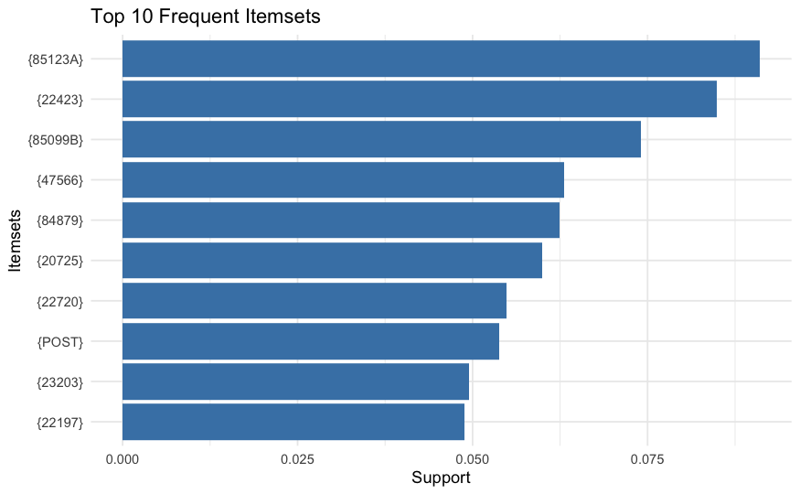
ASSOCIATION ALGORITHM - ECLAT
.
The Eclat algorithm is a frequent itemset mining technique used in machine learning and data mining to discover patterns in transactional datasets.
Recursively explores transactions in a database, building "equivalence classes" of items that frequently appear together.
The chart highlights the top 10 most frequent itemsets, with “White Hanging heart light holder” having the highest support at 0.075.
ANALYSIS OF ONLINE RETAIL SALES | INFO 523 DATA MINING | COLLEGE OF INFORMATION SCIENCE | UNIVERSITY OF ARIZONA

Slide 17
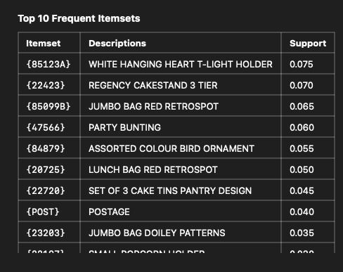
The high support values indicate these items were frequently purchased together, making them significant for association rule mining.

Slide 18
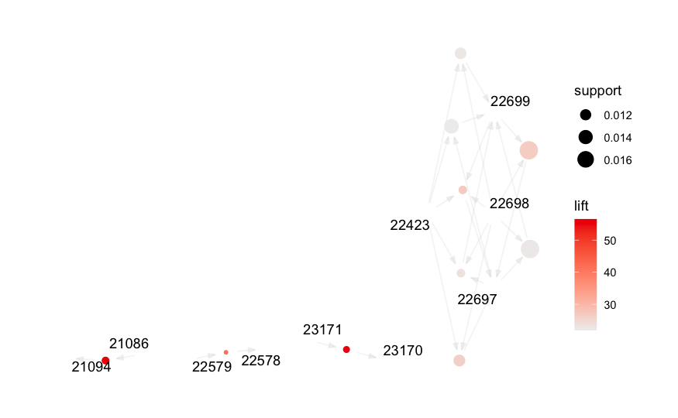
ASSOCIATION ALGORITHM - FP GROWTH ALGORITHM
FPGrowth is an algorithm for discovering itemsets (group of items) occurring frequently in a transaction database (frequent itemsets).
The graph illustrates association rules with nodes representing items, where larger nodes indicate higher support and darker edges reflect stronger lift values.
Key associations like {23171} → {23170} highlight strong relationships, with lift values above 50, suggesting these items are frequently bought together.
ANALYSIS OF ONLINE RETAIL SALES | INFO 523 DATA MINING | COLLEGE OF INFORMATION SCIENCE | UNIVERSITY OF ARIZONA

Slide 19
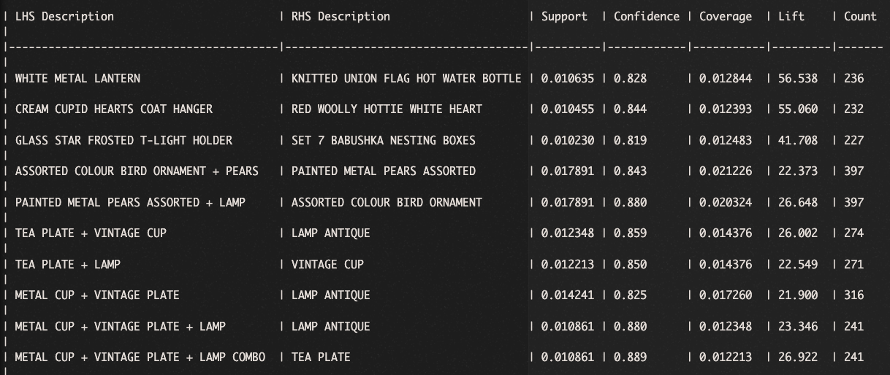
Support - Proportional frequency of an item in the database. Support(A) = Frequency(A) / # Total records
Confidence - how confident we are of an event, given another event. Confidence(A→B) = Probability(A & B) / Support(A)
Lift - a measure that tells us whether the probability of an event B increases or decreases given event A. Lift(A→B) = Confidence(A→B) / Support(B)

Slide 20
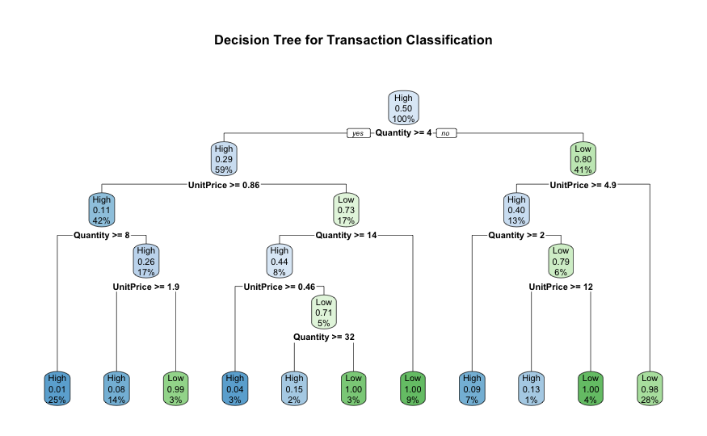
CLASSIFICATION ALGORITHM - DECISION TREE
Decision Tree for classifying the customer using transactions.
Creating a target variable AmountCategory that classifies transactions into "High" or "Low" based on the Amount.
Training a decision tree model (rpart) using predictors like Quantity, UnitPrice, Recency, Frequency, and Monetary.
ANALYSIS OF ONLINE RETAIL SALES | INFO 523 DATA MINING | COLLEGE OF INFORMATION SCIENCE | UNIVERSITY OF ARIZONA

Slide 21
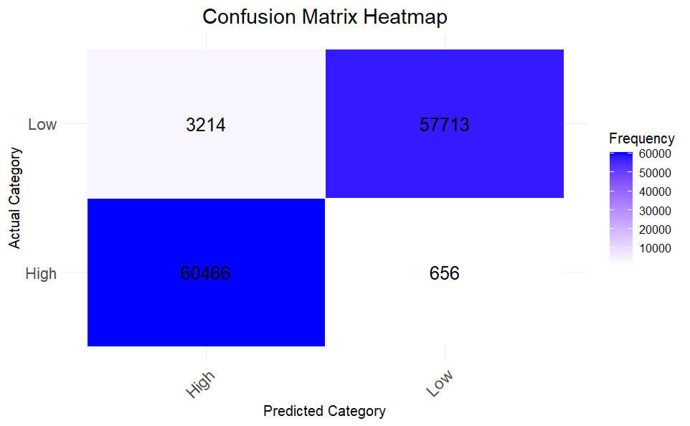
CLASSIFICATION ALGORITHM - DECISION TREE
Accuracy: 0.9682914
Precision (High): 0.9495289
Recall (High): 0.9892674
F1-Score (High): 0.9689909
Precision (Low): 0.9887612
Recall (Low): 0.9472483
F1-Score (Low): 0.9675597
High Precision and Recall with balanced F1-score.
ANALYSIS OF ONLINE RETAIL SALES | INFO 523 DATA MINING | COLLEGE OF INFORMATION SCIENCE | UNIVERSITY OF ARIZONA

Slide 22
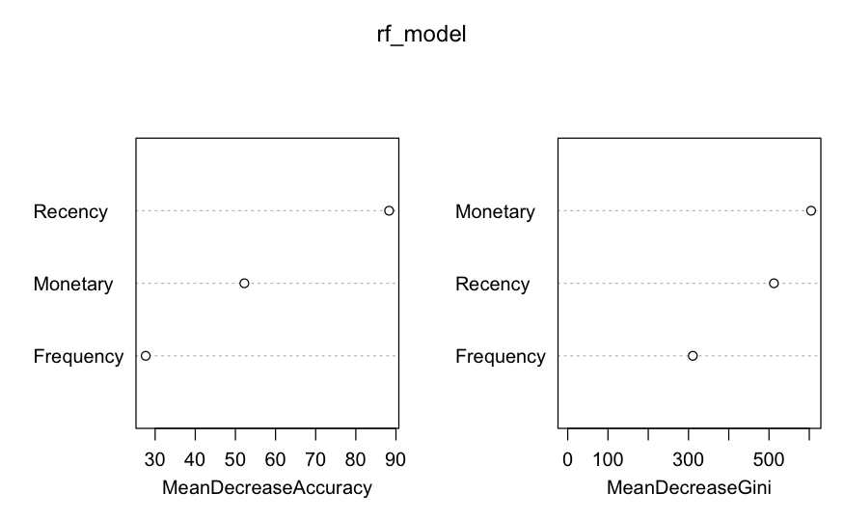
CLASSIFICATION ALGORITHM - RANDOM FOREST
A Random Forest model is trained using Recency, Frequency, and Monetary as predictors to understand the Churn.
Customers who haven't made a purchase in the last 6 months are flagged as churned (Churn = 1), while active customers are flagged as 0.
Accuracy: 0.7739464
Precision (Churn): 0.6871036
Recall (Churn): 0.6885593
ANALYSIS OF ONLINE RETAIL SALES | INFO 523 DATA MINING | COLLEGE OF INFORMATION SCIENCE | UNIVERSITY OF ARIZONA

Slide 23
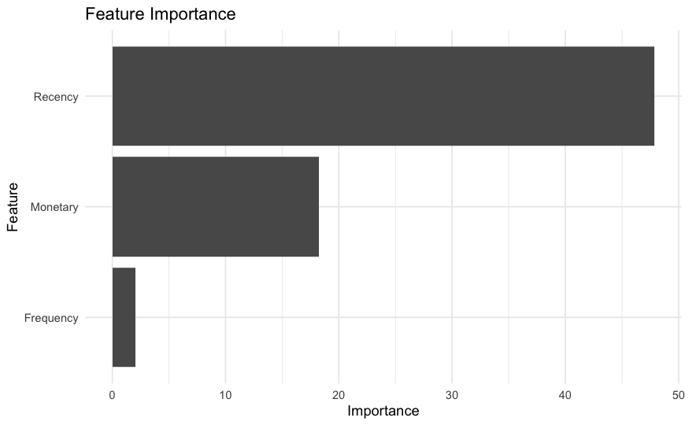
CLASSIFICATION ALGORITHM - RANDOM FOREST
Performance Metrics:
Out-of-Bag (OOB) Error Rate: 23.61%.
Confusion Matrix:
For the training set, the model shows class errors of 33.45% for class 0 (non-churn) and 17.84% for class 1 (churn).
Feature Importance:
Recency has the highest mean decrease in accuracy (88.29635) and Gini (512.2293), indicating its significant impact on the model's predictive power.
Monetary and Frequency also contribute, but to a lesser extent.

Slide 24

CONCLUSION
Clustering: Identified customer segments for targeted marketing and personalized experiences.
Classification: Predicted churn analysis, aiding inventory management and sales forecasting.
Association: Uncovered product relationships for cross-selling and strategic promotions.
ANALYSIS OF ONLINE RETAIL SALES | INFO 523 DATA MINING | COLLEGE OF INFORMATION SCIENCE | UNIVERSITY OF ARIZONA

Slide 25
THANK YOU

